Slide 1
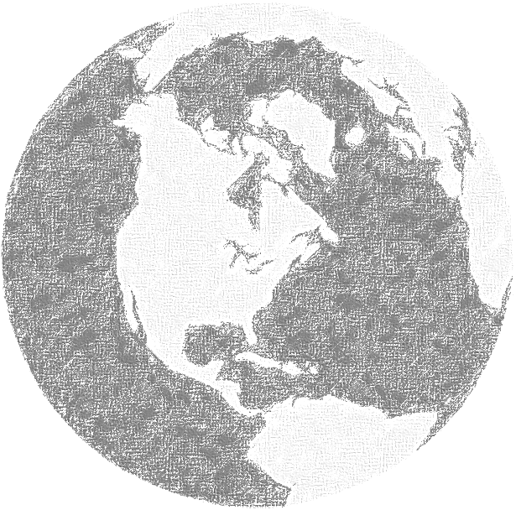
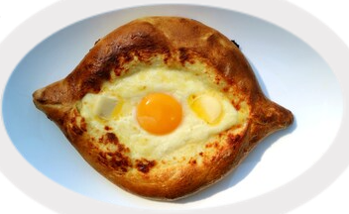
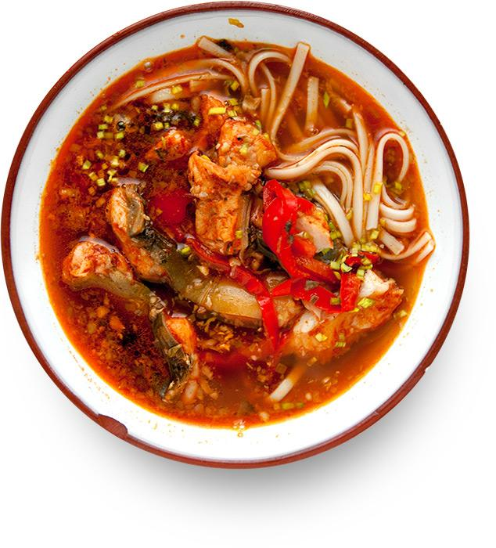
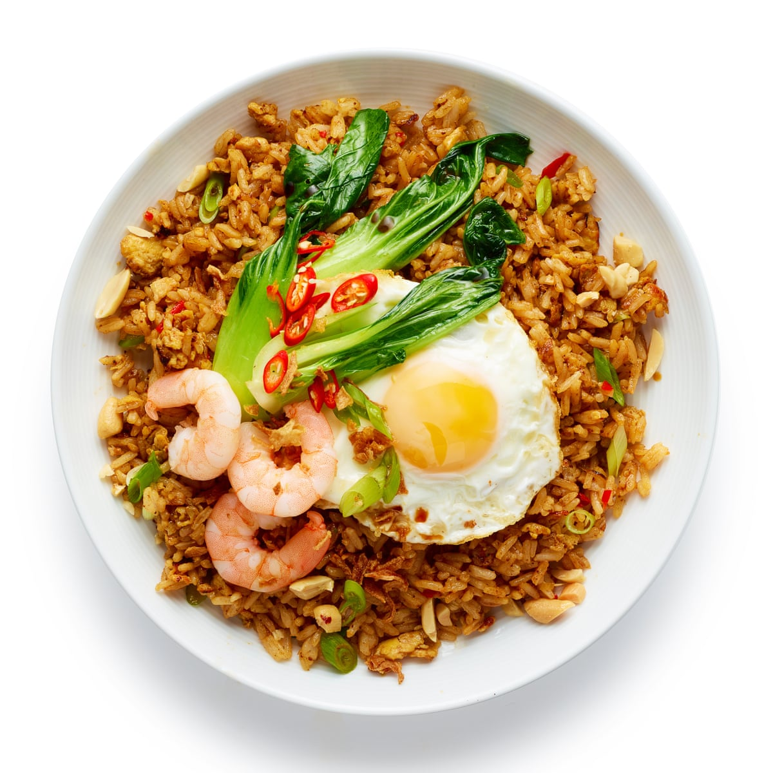
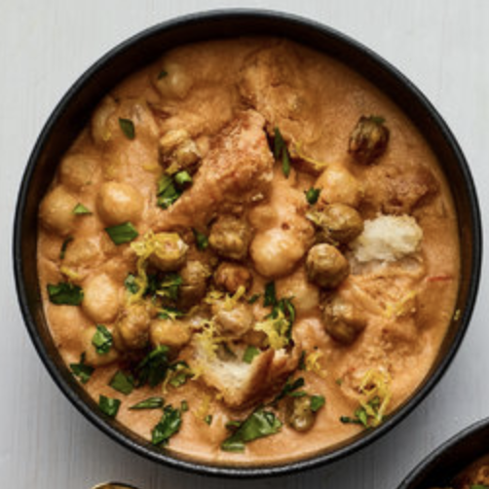



















Wiki2Vec
by Ian Livingston
Khachapuri
Georgia
Halászlé
Hungary
Nasi goreng
Indonesia
Lablabi
Tunisia

Slide 2
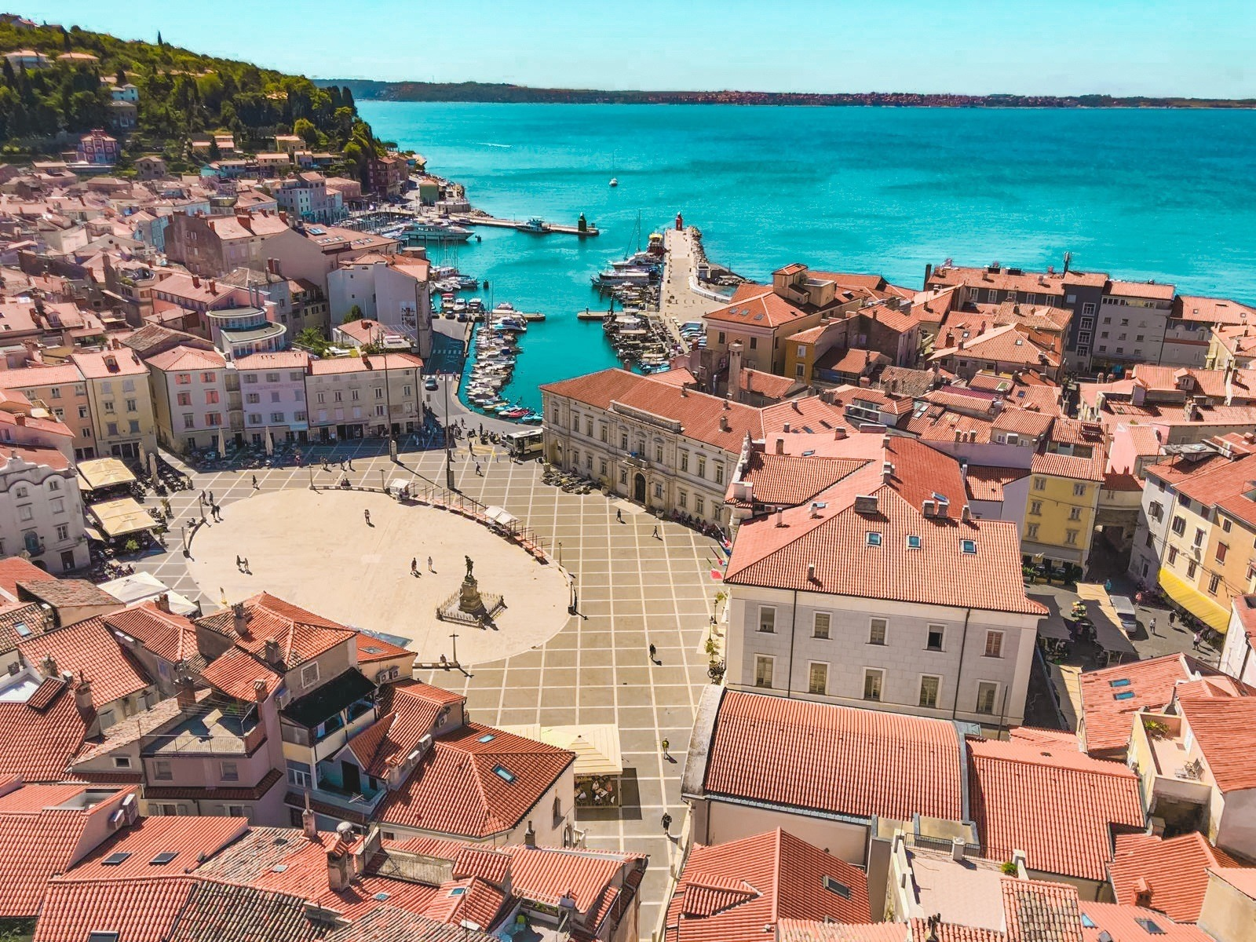
Setup
Prague
Czechia
Gdańsk
Poland
～
Attempt #1
Travel tool measuring cross-cultural similarity among destinations around the globe
Vectorize language and measure distance
Collected and parsed text from ~500,000 Wikipedia pages
Trained a neural network and extracted a 50-neuron embedding
～
?
Santa Barbara
USA
～
～
?
～
～

Slide 3
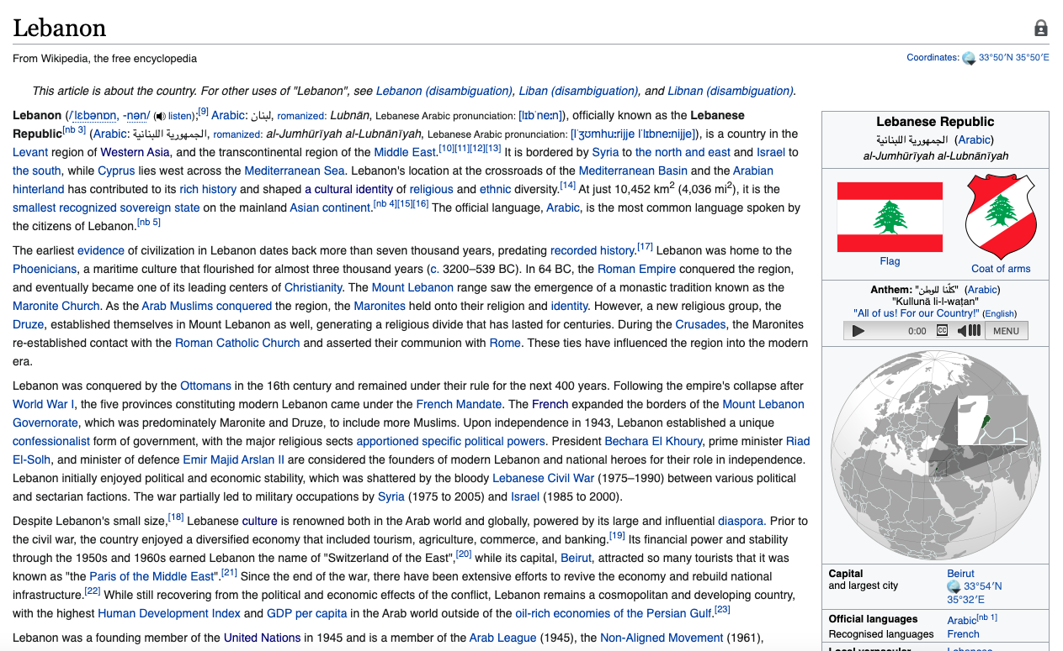
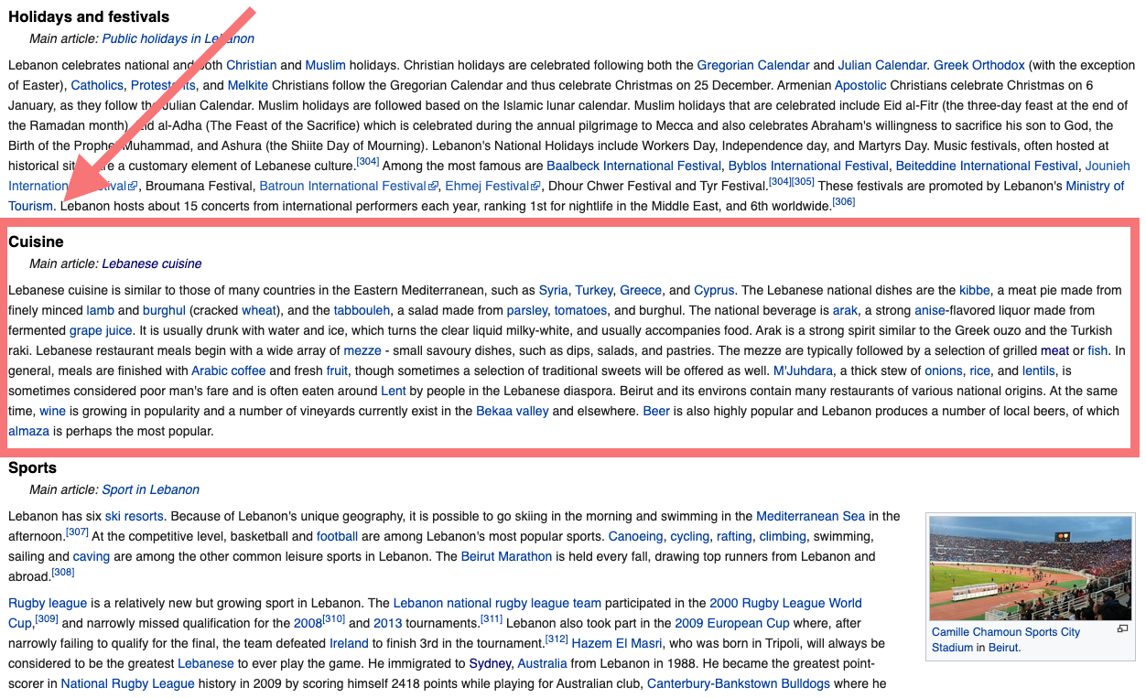
Setup
An example page
Pivot
Results:
A necessary refitting of
scope to the data
What about cuisines?

Slide 4
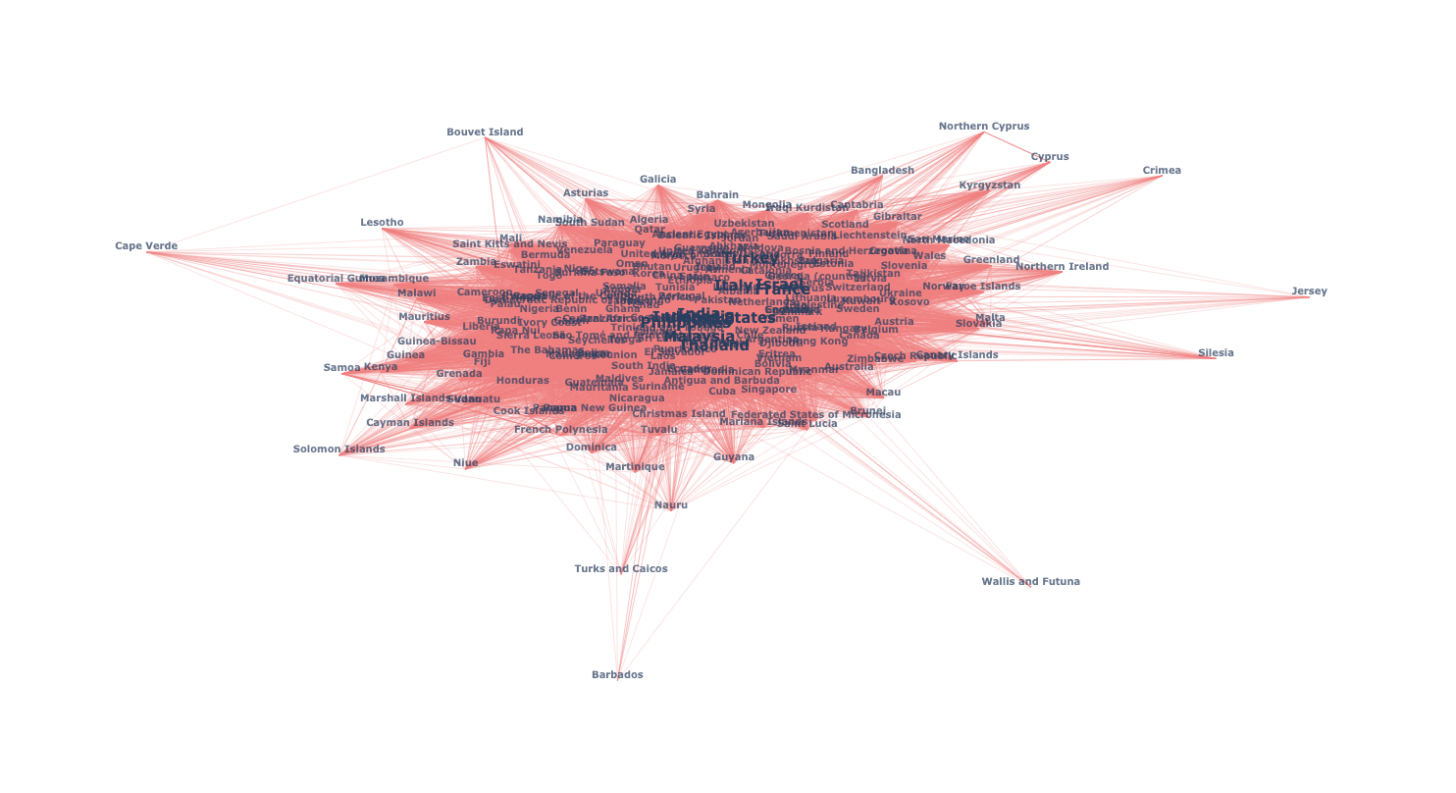
Setup
Pivot
Results:
Too broad and not enough data
What about dishes?
Attempt #2
Cosine similarity
among cuisines
~240 Wikipedia
cuisine pages
Notes:
Networkx and Plotly
edges and nodes
36,000 shared Wikilinks (6,000 unique)
United States: 1273 links
Indonesia: 831 links

Slide 5

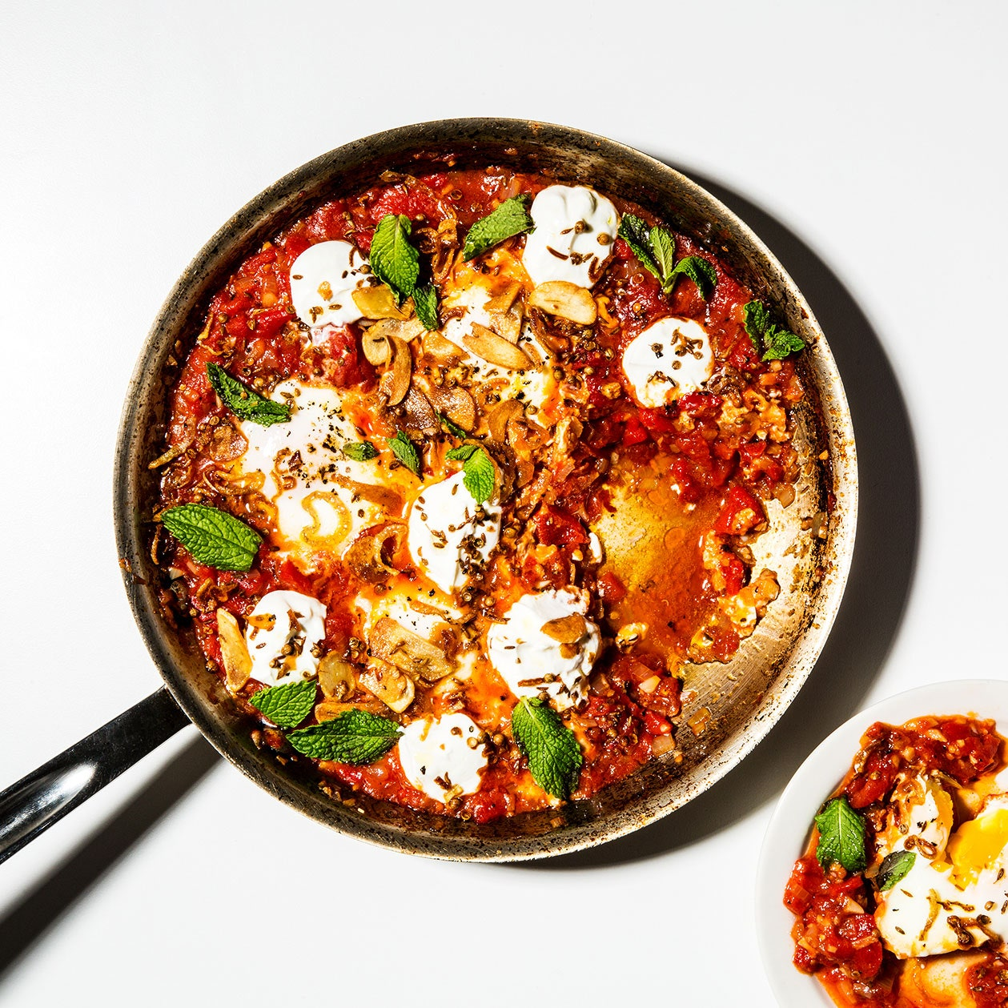
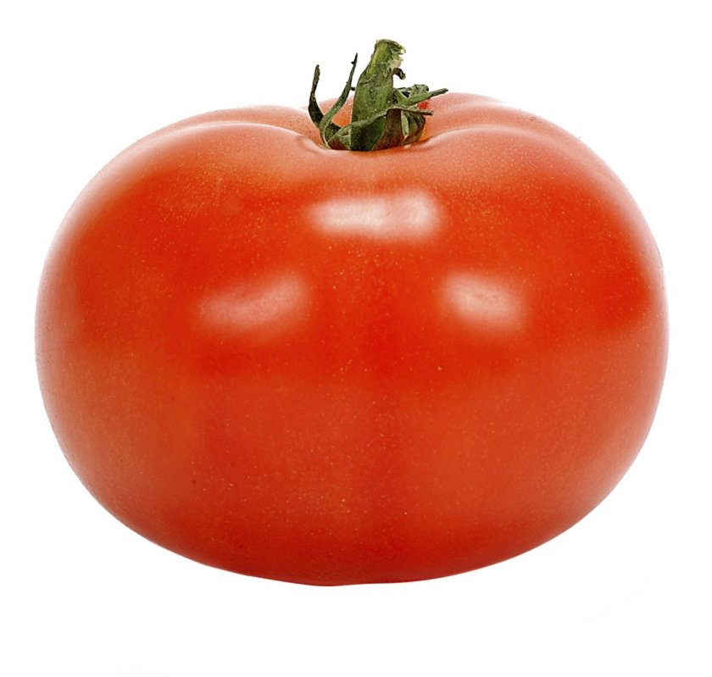
Setup
Following the data
Thousands of foods and dishes out of view for people, far from their places of origin
Food is a lens into culture and also good
People like tomato and don’t know about shakshuka
Attempt #3
Stay with Wikipedia
Collect foods and dishes from around the world in one dataset
Vectorize foods and dishes from around the world
Serve results in an app
=

Slide 6
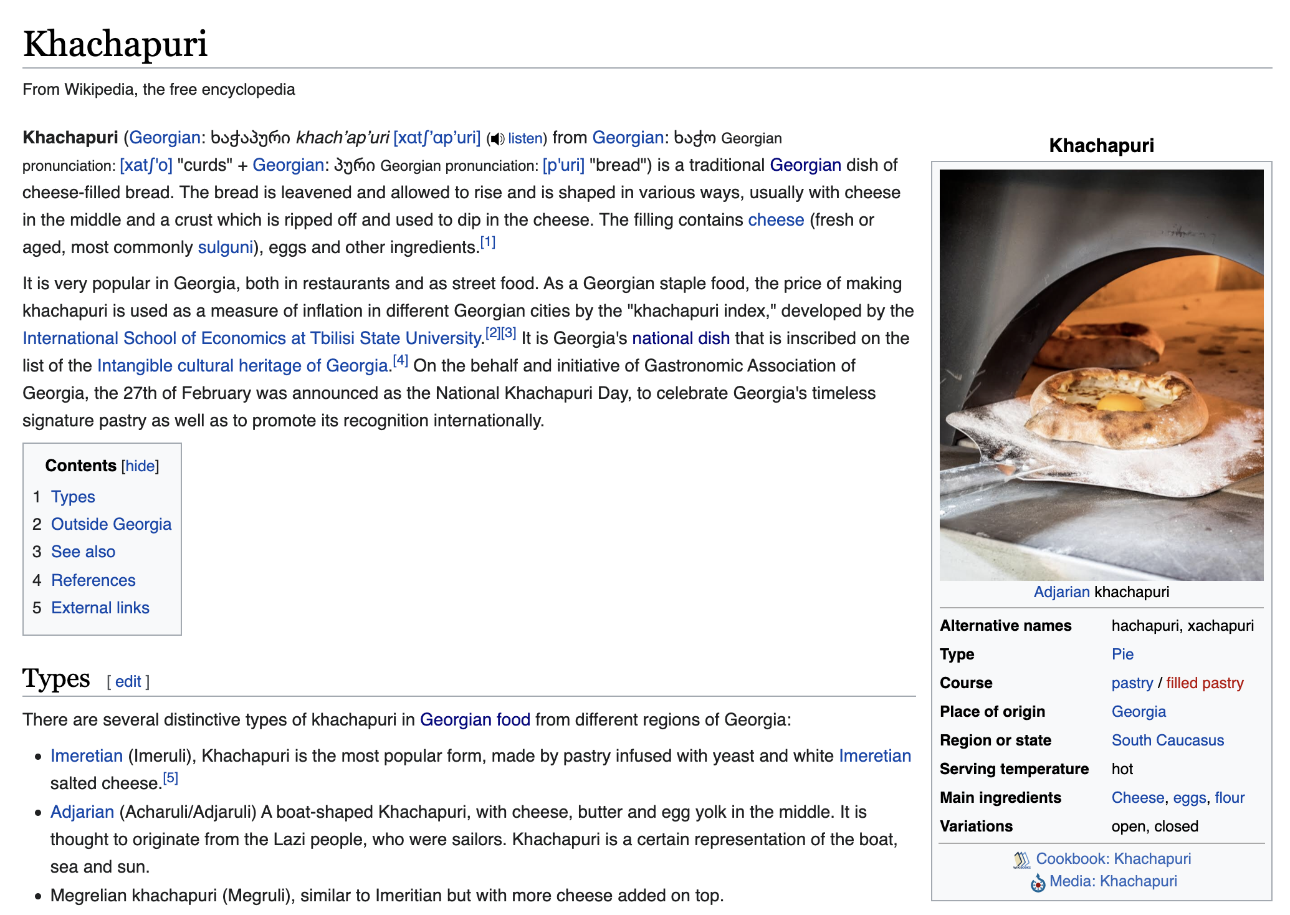
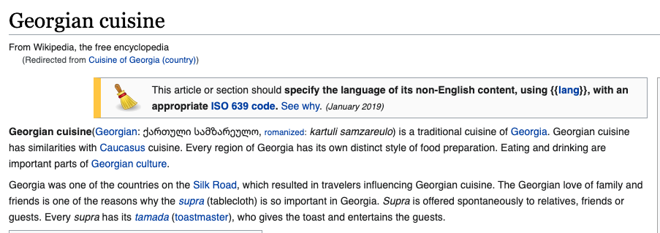
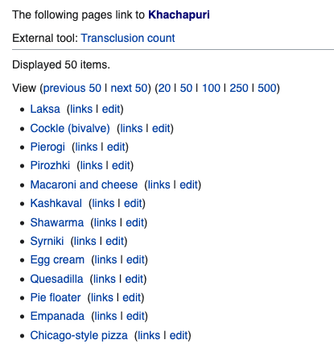
Approach
Example dish: Khachapuri
Vectorization
2,278 dishes = 2,278 vectors
Documents built from Wikipedia
Customized stopwords
and “startwords”*
[“Spicy”, “sweet”...]
[“Breakfast”, “street food”...]
[“India”, “Levantine”...]
Page text
Page infobox
National cuisine page
Backlinks
*Good term from: Tim

Slide 7
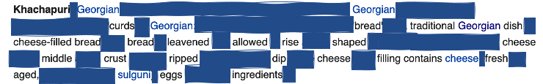





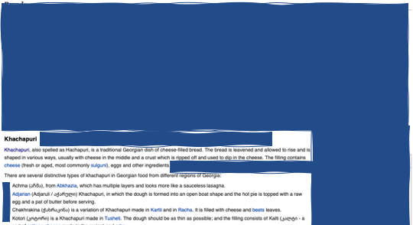
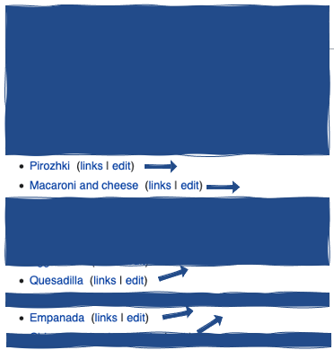
Approach
Example vector: Khachapuri
0.001485 0.011571 0.001625 0.009290 0.011701
...
0.001646 0.001724 0.009176 0.002326 0.004833
Example dish: Khachapuri
[
Extensive cleaning
Cosine similarity
(2278 × 9417
matrix)
POS-tagging,
stopwording,
startwording,
lemmatization
]

Slide 8
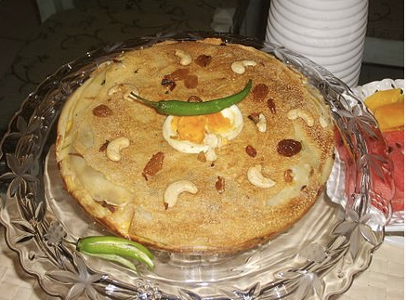
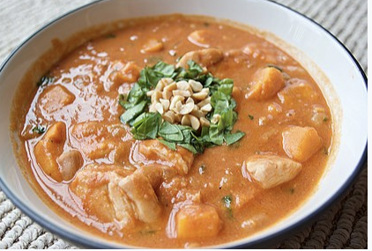
Results
Chatti pathari
Khachapuri
Simple:
Vectors closest to 1
[
0.001485 0.011571 0.001625 0.009290 0.011701
...
0.001646 0.001724 0.009176 0.002326 0.004833
FROM
SELECT
Better:
Vectors closest to 1
filtering
for user preference
(region, flavor, etc.)
Chicken mull
]

Slide 9
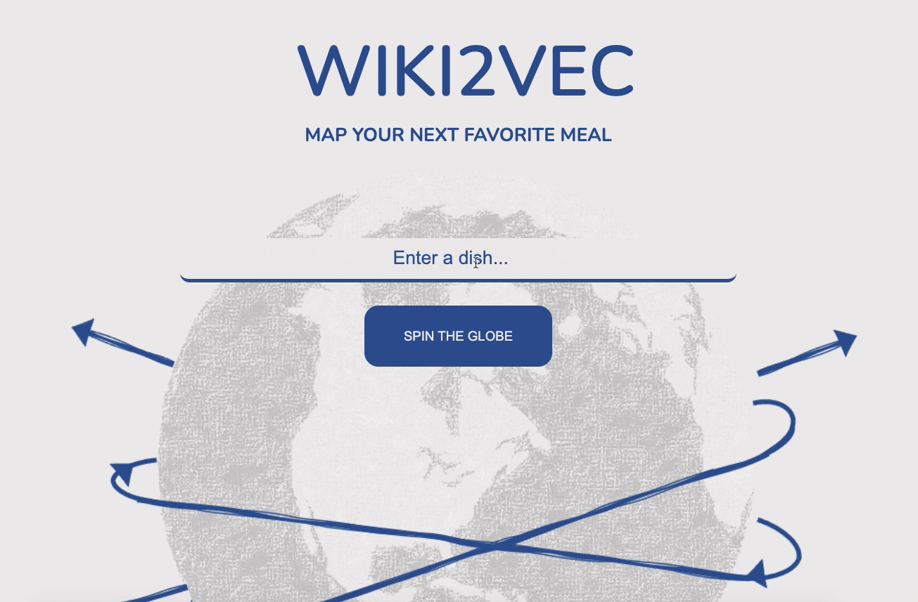
App

Slide 10
Next
Expand dataset
More dishes/datapoints
More variance explained via more/better features
Wikipedia international
Beyond Wikipedia
Employ transfer learning
Leverage existing models
Add to app UX/UI
Taste/category input options
Link-outs to recipes, where to find dish nearby, where to get ingredients nearby...
Notes:
Chatti pathari: buttery, cheesy dish of flour, egg, pastry in Kerala
Chicken mull: comfort food that is a cultural staple in North Carolina –”mull season”

Slide 11
References
Wikipedia, https://en.wikipedia.org
Altosaar, Jaan, “food2vec - Augmented cooking with machine intelligence,” https://jaan.io/food2vec-augmented-cooking-machine-intelligence
Koehrsen, Will, “Wikipedia Data Science: Working with the World’s Largest Encyclopedia,” https://towardsdatascience.com/wikipedia-data-science-working-with-the-worlds-largest-encyclopedia-c08efbac5f5c
Free Frontend, https://freefrontend.com
Ballard, Callum, “How To Evaluate Unsupervised Learning Models,” https://towardsdatascience.com/how-to-evaluate-unsupervised-learning-models-3aa85bd98aa2

